Slide 1
Entrepreneurship
Presented by-
Prakhar Kansal

Slide 2
Perception
Interviewer : How long will you have to work to buy BMW?
Doctor : I think I can buy one in 6-8 months of my practice
MBA : I need about 11-12 months of hard work Engineer : At least 2-3 years of very hard work.
Entrepreneur : I think ..... about 5 years Interviewer : Why so long , Sir?
Entrepreneur : Well , it's not easy , BMW is a big company!

Slide 3


Slide 4
Importance of Entrepreneurship
~Lifestyle
~ Productivity
~Job creation
~Economy
~Innovation ideas
~Technology

Slide 5
New Firms In Past Years

Slide 6


Decade Of Entrepreneurship
India has over 61,400 startups (atleast ,14,000 in 2022)
Remarkable growth over last six years The Third-Largest Startup Ecosystem Increase Fund Raising

Slide 7
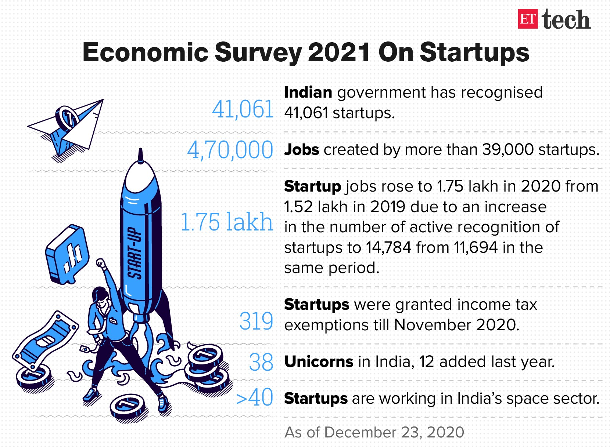

Slide 8

Types of Entrepreneurship
Small Business
Online Business Home-Based Business Serial Business

Slide 9




ROLE OF GOVERNMENT
SCHEMES -
Start-up India
Credit Guarantee Fund Trust for Micro and Small Enterprises (CGTMSE)
ATAL Innovation Mission Raw Material Assistance etc.

Slide 10
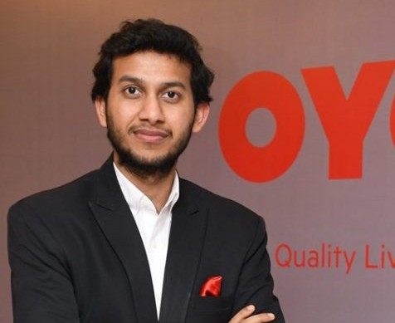



Ritesh Agarwal
He is the Founder and CEO of Oyo Rooms
With Network of 2,200 Hotels operating in 154 Cities across India
With monthly revenues of
$3.5m and 1,500 employees

Slide 11
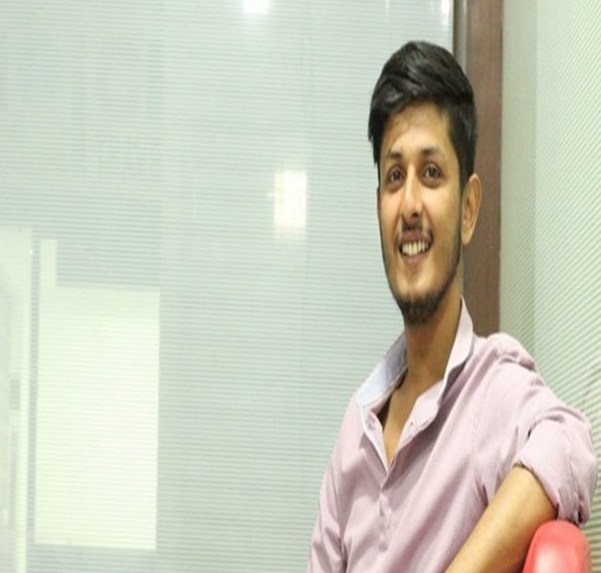




Anubhav Dubey
A 25-year Man
Co-founder of Chai Sutta Bar He is from Indore, Madhya Pradesh
He went to Delhi to prepare for UPSC and to become an IAS Officer
Just a call away from his journey

Slide 12
Thannnkkk
youuu!!!

Slide 13
References
https://www.entrepreneur.com/article/345760
https://economictimes.indiatimes.com/tech/startups/economic-survey-2022-at- least-14000-
new-startups-recognised-in-india/articleshow/89243366.cms https://www.slideshare.net/lerato25/entrepreneurship-powerpoint-slide

